Slide 1
Degree Sequence of a Graph
kobriendublin.wordpress.com
Twitter: @kobriendublin

Slide 2
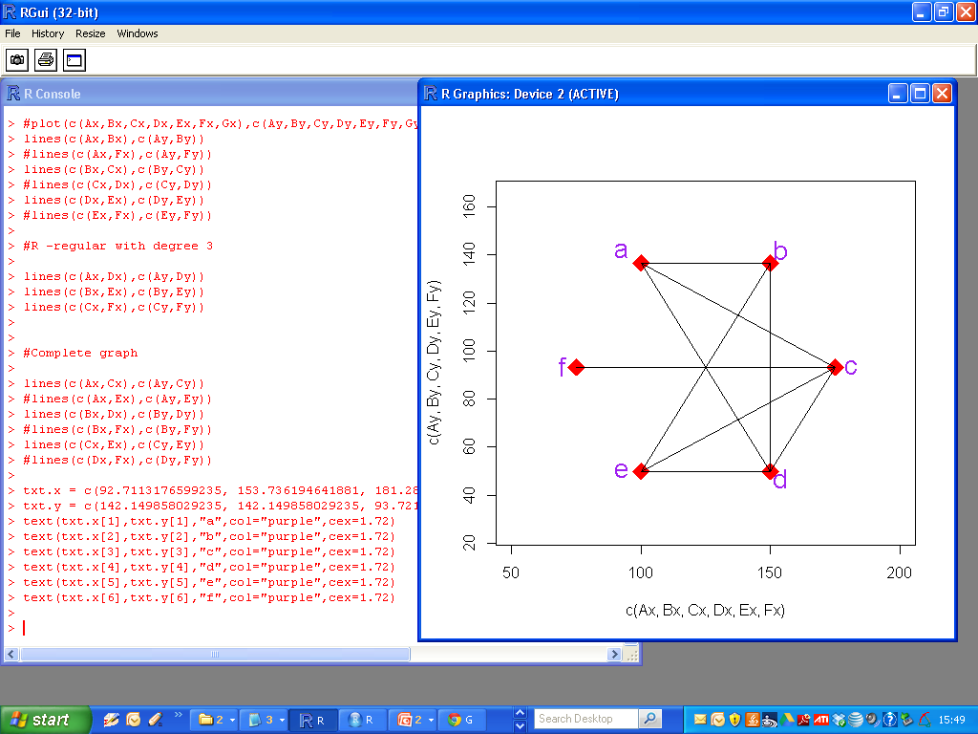
Degree Sequence of a Graph

Slide 3
Degree Sequence of a Graph
The degree of a vertex on a simple graph is the number of edges connected to that vertex.
The degree sequence is the sequence of these degree values, arranged from the largest value to smallest.

Slide 4

Degree Sequence of a Graph

Slide 5
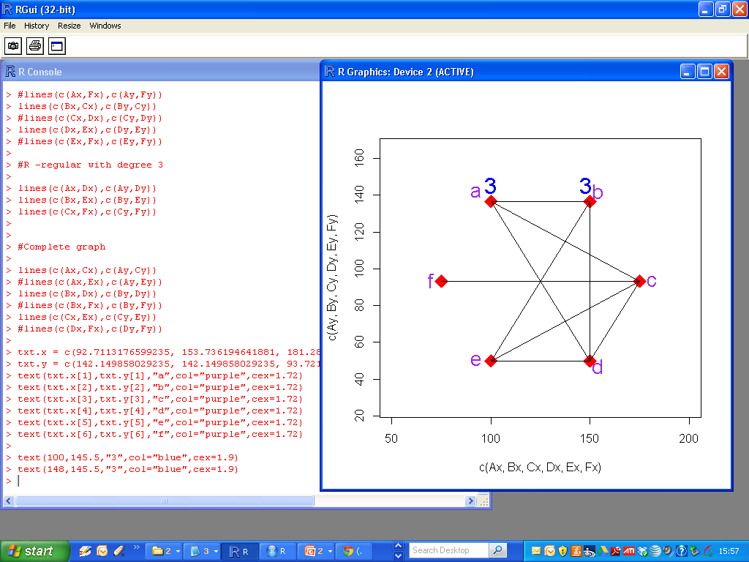
Degree Sequence of a Graph

Slide 6
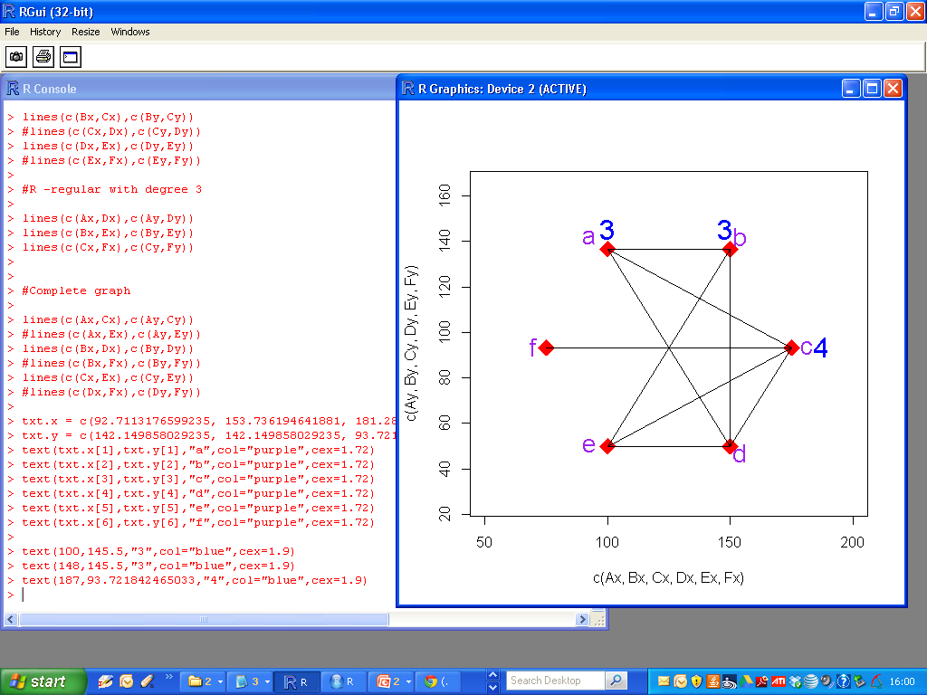
Degree Sequence of a Graph

Slide 7

Degree Sequence of a Graph

Slide 8
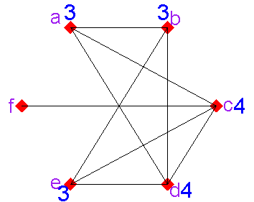
Degree Sequence of a Graph

Slide 9
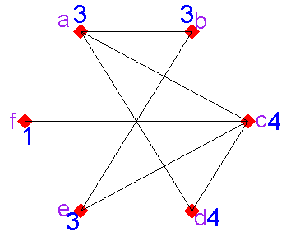
Degree Sequence of a Graph

Slide 10
Degree Sequence of a Graph
Vertex | Degree | Vertex | Degree
A | 3 | D | 4
B | 3 | E | 3
C | 4 | F | 1
Degree Sequence of a Graph

Slide 11
Degree Sequence of a Graph
Vertex | Degree | Vertex | Degree
A | 3 | D | 4
B | 3 | E | 3
C | 4 | F | 1
Degree Sequence = { 4, 4, 3, 3, 3, 1}
(Sum of degree sequence is 18, an even number).

